Slide 1
Microservices Migration Patterns
Damian A. Tamburri, Ph.D.

Slide 2
Right… where were we?

Slide 3


Slide 4
Microservices ➔ Deployment
A software system cannot fulfill its purpose until it is deployed; µS are an abstraction to aid that!
  Executable modules are physically placed on the containers (instead of hardware devices) on which they are supposed to run
The deployment view of an architecture can be critical in assessing whether the system will be able to satisfy its requirements
Possible assessment dimensions
  Available memory
  Power consumption
  Required network bandwidth

Slide 5
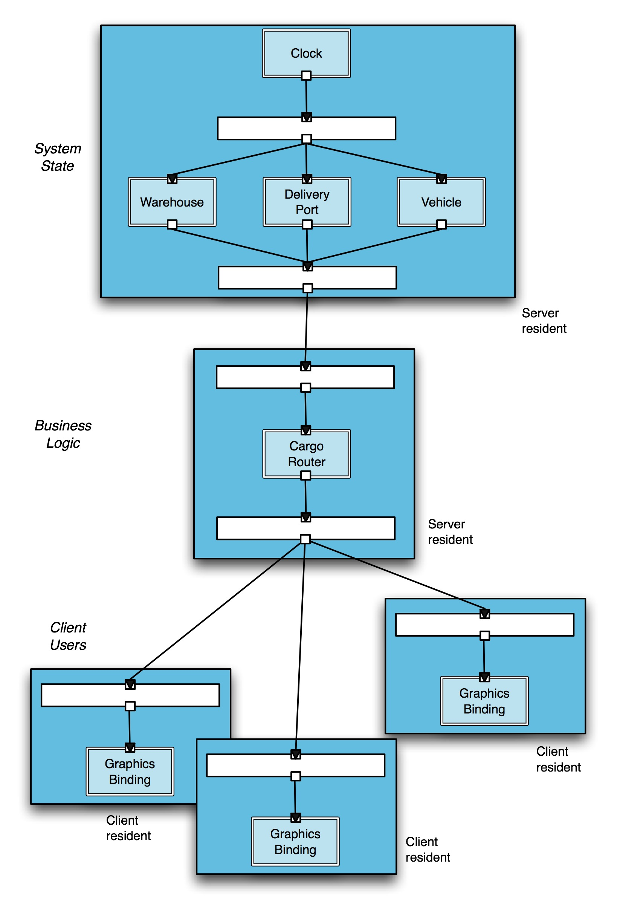
A Legacy System’s Deployment Architectural Perspective
Software Architecture: Foundations, Theory, and Practice; Richard N. Taylor, Nenad Medvidovic, and Eric M. Dashofy; © 2008 John Wiley & Sons, Inc. Reprinted with permission.

Slide 6
Migrating to Microservices Requires an architectural Perspective
A software system’s architecture typically is not (and should not be) a uniform monolith
A software system’s architecture should be a composition and interplay of different elements
  Processing
  Data, also referred as information or state
  Interaction

Slide 7
Microservices
Elements that encapsulate processing and data in a system’s architecture are referred to as software component containers
Definition
  A software container is an architectural entity that
    encapsulates a subset of the system’s functionality and/or data
    restricts access to that subset via an explicitly defined interface
    has explicitly defined dependencies on its required execution context
Components typically provide application-specific services

Slide 8
For example: Eliciting/Modelling the Connectors
In complex systems interaction may become more important and challenging than the functionality of the individual components
Definition
  A software connector is an architectural building block tasked with effecting and regulating interactions among components
In many software systems connectors are usually simple procedure calls or shared data accesses
  Much more sophisticated and complex connectors are possible!
Connectors typically provide application-independent interaction facilities

Slide 9
Examples of Connectors
Procedure call connectors
Shared memory connectors
Message passing connectors
Streaming connectors
Distribution connectors
Wrapper/adaptor connectors

Slide 10
For example: Extracting the Configurations
Components and connectors are composed in a specific way in a given system’s architecture to accomplish that system’s objective
Definition
  An architectural configuration, or topology, is a set of specific associations between the components and connectors of a software system’s architecture

Slide 11

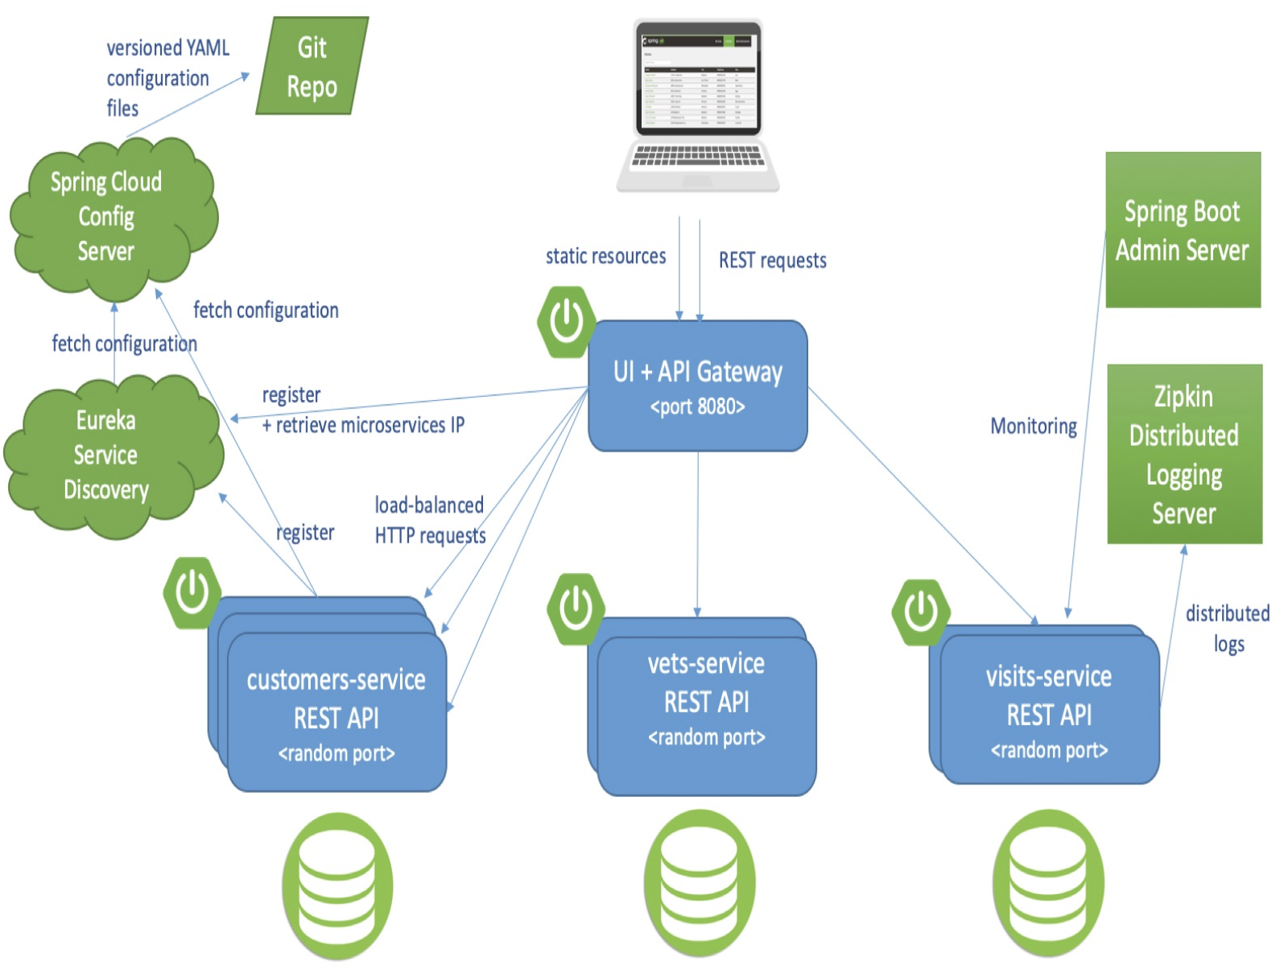
An Example Configuration
Software Architecture: Foundations, Theory, and Practice; Richard N. Taylor, Nenad Medvidovic, and Eric M. Dashofy; © 2008 John Wiley & Sons, Inc. Reprinted with permission.

Slide 12
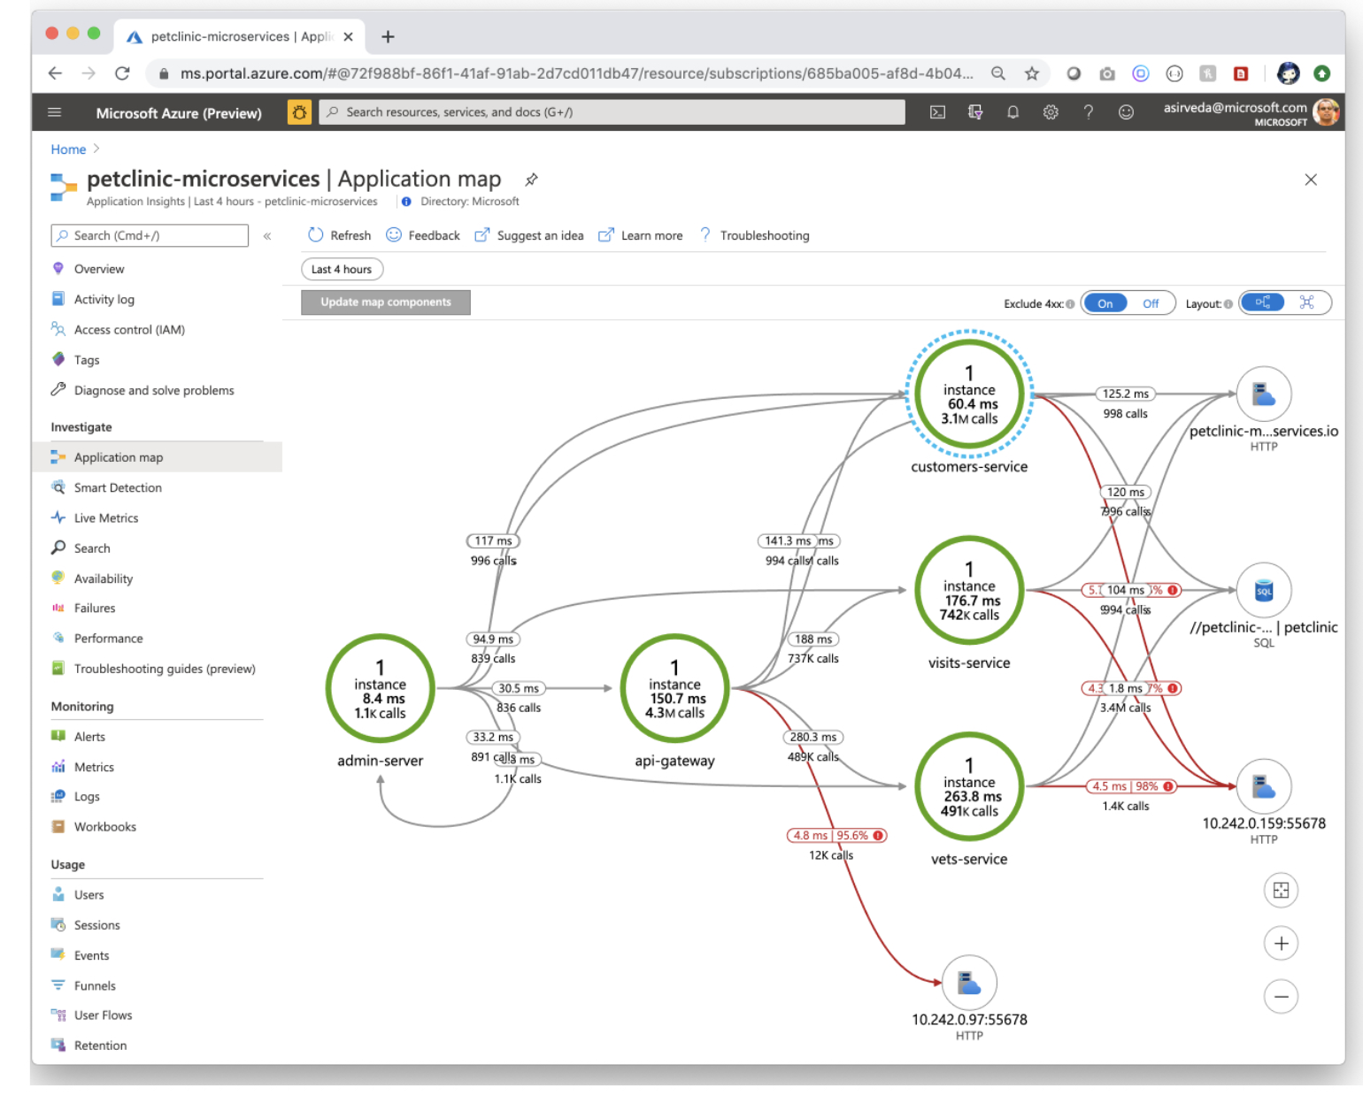

Slide 13
What problem do we need to solve? Monolithic Systems
Little to “no architecture”
reports
static data
imported data
dynamic data

Slide 14
How do I migrate from these monoliths* to µS*?
Empirical study ➔ 30+ industrial migration efforts
Practitioner card-sorting + pattern mining
* Balalaie A, Heydarnoori A, Jamshidi P, Tamburri DA, Lynn T. Microservices migration patterns. Softw Pract Exper. 2018; 48: 2019–2042. https://doi.org/10.1002/spe.2608

Slide 15
Mainframe Replication and Disaster Recovery Services
Problem Statement:
The GPAA has its own mainframe in one of our Data Centers.
The CIVPEN (NATURAL/ADABAS), the core business application is hosted on the mainframe (Since 1992).
The CIVPEN application comprise of two production Adabas Databases (Active - 597 833 649 Records) (History (Read only) - 904 225 347 records and growing)
Other critical business applications are tightly integrated with the CIVPEN (Civil Pensions) application. Integration is primarily via COMPLETE’s HTTP Server.
Notes:
https://www.google.com/url?sa=t&source=web&rct=j&opi=89978449&url=https://www.gpaa.gov.za/downloads/Presentation_Mainframe_Replication_bid_(GPAA_03_2015).pptx&ved=2ahUKEwir0PObze-JAxXy_7sIHd7JKQEQFnoECCMQAQ&usg=AOvVaw2BRZvrSR2X5Wc1uT5XHhNK

Slide 16
Mainframe Replication and Disaster Recovery Services
Problem Statement (cont):
The GPAA does not have a DR facility with dedicated infrastructure for the mainframe (Used a Syndicated environment)
In case of a disaster the recovery of the mainframe and application takes anything from 12 to hours (Tape based) - Current RPO = 1 hour – Business expected RPO – Not achievable.
During the recovery time most of the other business applications are also unavailable due to the tight integration. This is not acceptable to our business and clients and need to be addressed.

Slide 17
Mainframe Replication and Disaster Recovery Services
Objectives:
Reduce the RTO and RPO to as minimal possible by employing new techniques and technology
Move to a position where we have a ‘Hot Standby’ solution reducing the RPO significantly – to be in line with the other applications (minimal data loss and cross application data integrity problems ).
There are various ways to replicate the data between the active and the warm standby platform but we will leave this to the innovation of the respondents.
Move away from the recovery from Cassettes.
The GPAA is in a modernisation phase where one of the objectives is to migrate the mainframe to a more modern Software Platform.

Slide 18
Mainframe Replication and Disaster Recovery Services
Challenges and Points to note:
The PLOGS/Archive logs are not switched on, on the History Database.
The PLOGs/Archive logs are also not switched on, on the active database when we process our monthly Payment and Contribution Reconciliation runs. This is due to the volume of the transactions and the PLOGS that will be created. We protect ourselves by means of full backups before and after the respective runs (twice per month over weekends).
Archiving of data from the Active database to the History database is done once a month (at least) and because the Archive database is Read Only we archive on a file mechanism rather than on a Record mechanism using Adabas utilities.
During a DR or a DR test the GPAA’s mainframe support staff will operate the mainframe/LPAR dedicated to the GPAA at the Service Provider’s Data Centre.
The GPAA will conduct regular verifications to ensure that the data on the two systems are fully in synch.

Slide 19
Mainframe Replication and Disaster Recovery Services
Technical Information about Our Mainframe:
IBM zBC12
Machine type: 2828 I02
Hardware model: H06
Capacity setting: I02 - 274MIPS total, 150MIPS UP, 34MSU
User memory: 16GB
FICON (disk,CTC+tape)channels: 12*8GB/s MM
Storage - 2421-961- IBM DS8870

Slide 20
Mainframe Replication and Disaster Recovery Services
Technical Information about Our Mainframe (Cont):
3.6TB DASD storage dedicated disk storage for replication
140 MIPS (in case of Test or invocation). The full 140 MIPS should only be active in the case of a test or a real disaster. During the replication the MIPS utilization should be limited to the maximum capacity that will be required for the replication.
The service provider to propose how many MIPS will be required for the replication.
ZOS 2.1 capable operating system.
3592 tape drives for bulk data restores and for backups

Slide 21
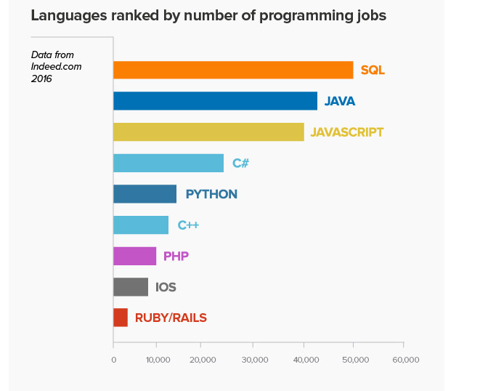

Challenges
High expenses
Mainframe is no longer a platform of choice
Customers are re-hosting on Windows/Linux platforms
Agencies have dwindling support staff for their legacy systems
40% of WaTech mainframe employees eligible to retire within 5 years
Mainframe Languages:
JCL Natural COBOL REXX
Curriculum focuses

Slide 22
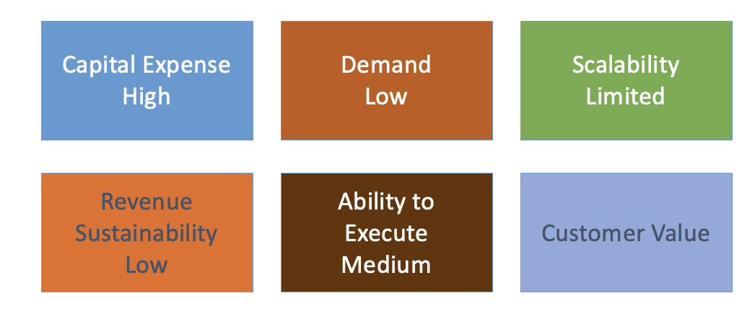
Criteria for Service Offer

Slide 23
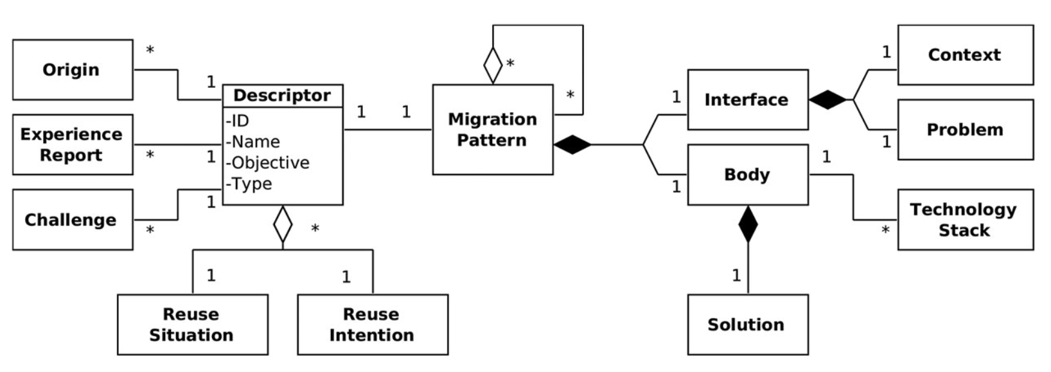
Microservices Migration Patterns

Slide 24
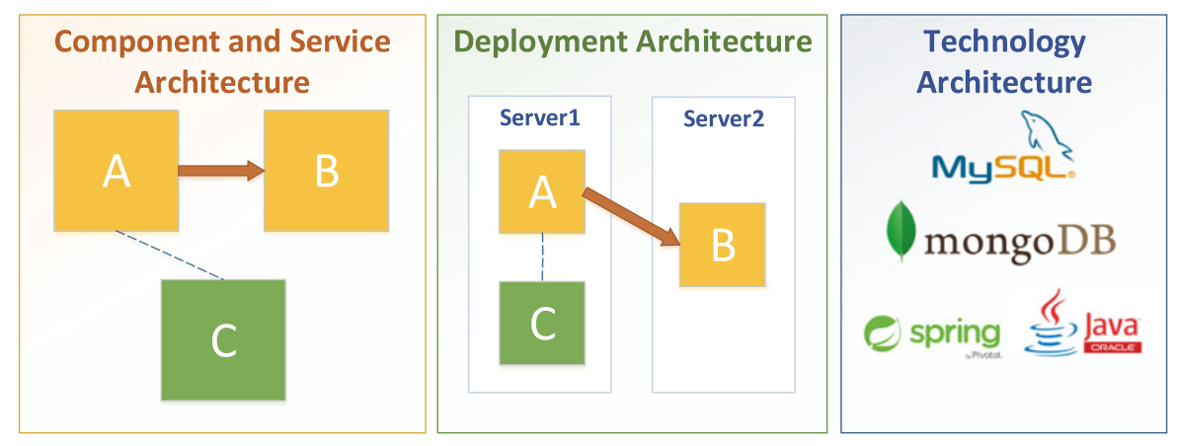
Recover the current architecture
There is a working monolithic software system, and the team responsible for maintaining the system has decided to migrate this system to microservices. In order to plan the migration, the team needs to know the current system architecture which either does not exist or is rather obsolete.

Slide 25
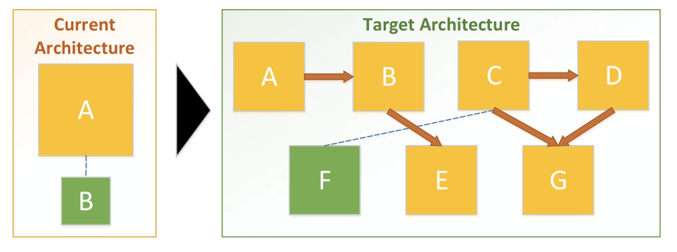
Decompose the monolith
There is a monolithic software system with a complex domain

Slide 26
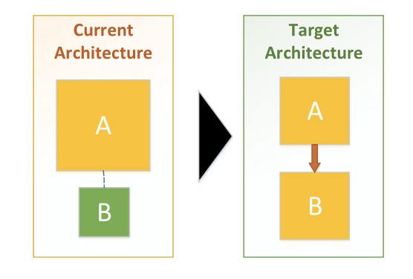
Change code dependency to service call
A software system has been decomposed to a set of small services to use a microservices architectural style. There is a component in the system that is acting as a dependency to other services or components.

Slide 27
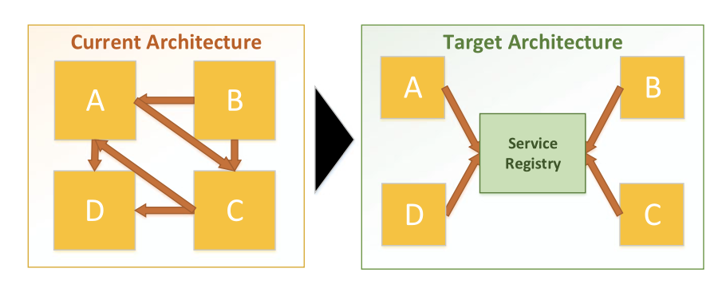
Introduce service registry
A software system has been decomposed to a set of small services to use a microservices architectural style, and each of these services has one or more instances deployed in the production environment. The number of instances can be changed dynamically, and each of them can be deployed in different systems.

Slide 28
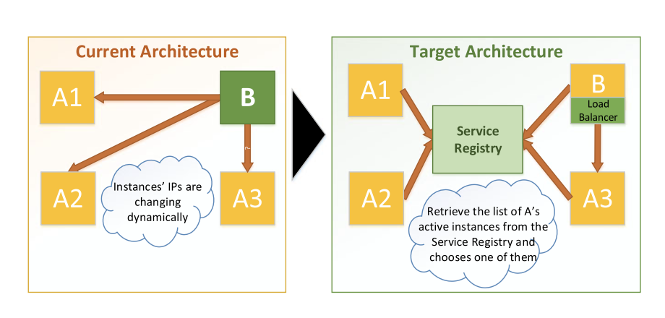
Introduce internal load balancer. IP, internet protocol
A software system has been decomposed to a set of small services to use a microservices architectural style, and a service registry has been set up. In the production environment, numerous instances of each service exist. Each service can be a client of the rest of the services in the system.

Slide 29
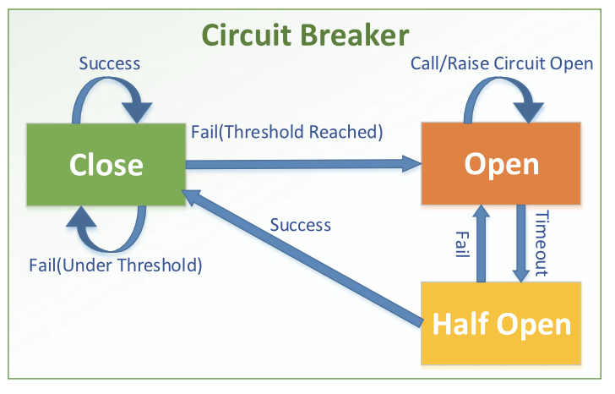
Introduce circuit breaker
A software system has been decomposed to a set of small services to use a microservices architectural style, and a service registry has been set up. In the production environment, numerous instances of each service exist. Each service can be a client of the rest of the services in the system.

Slide 30
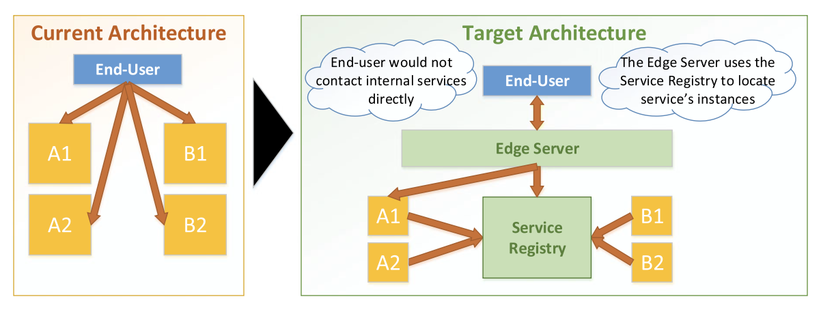
Introduce edge server
A software system has been decomposed to a set of small services to use a microservices architectural style. Due to ease of service initiation in the system, new services can be introduced easily, and existing services can be rearchitected based on new requirements.

Slide 31
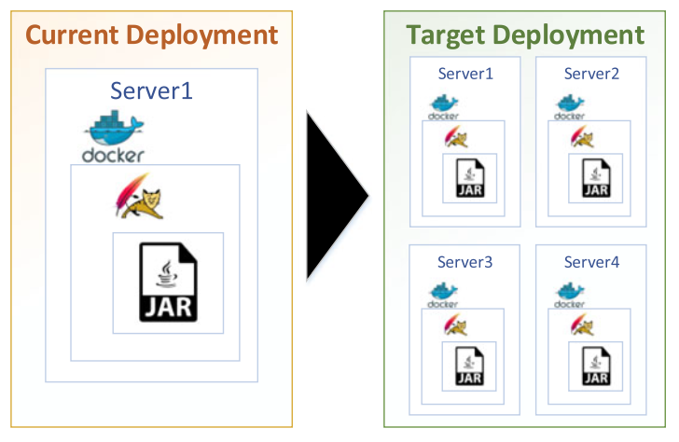
Containerize the services
A software system has been decomposed to a set of small services to use a microservices architectural style. Due to ease of service initiation in the system, new services can be introduced easily, and existing services can be rearchitected based on new requirements.

Slide 32
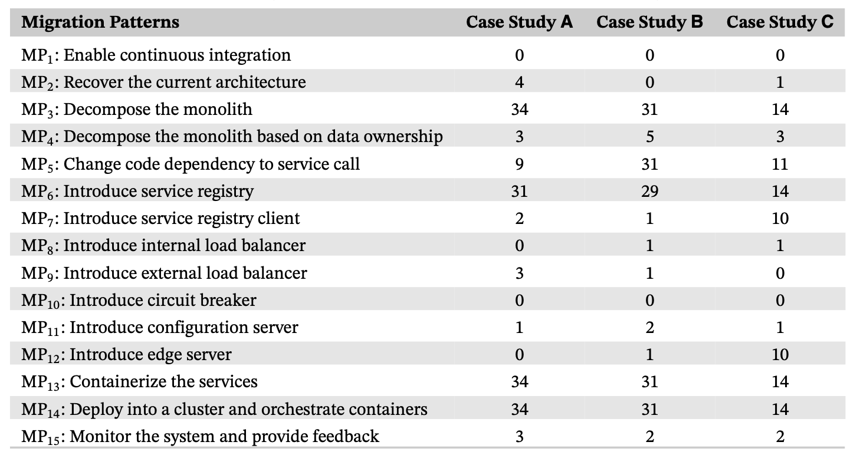
Evaluation of Industrial Results

Slide 33
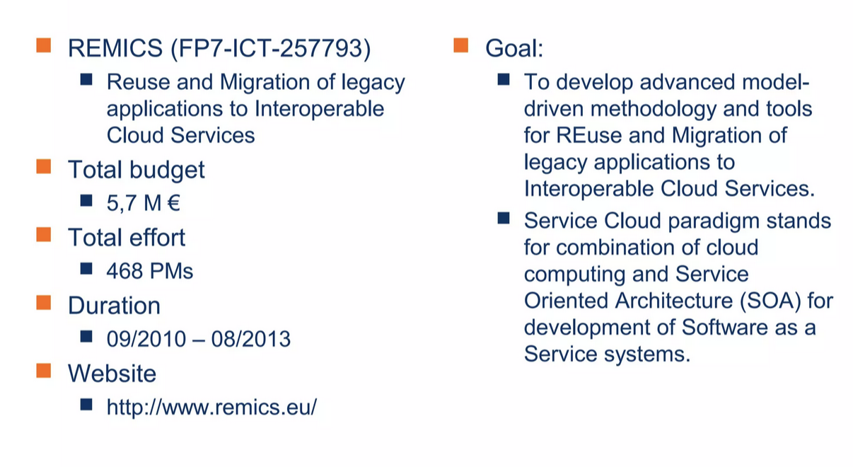
For Example: REMICS

Slide 34
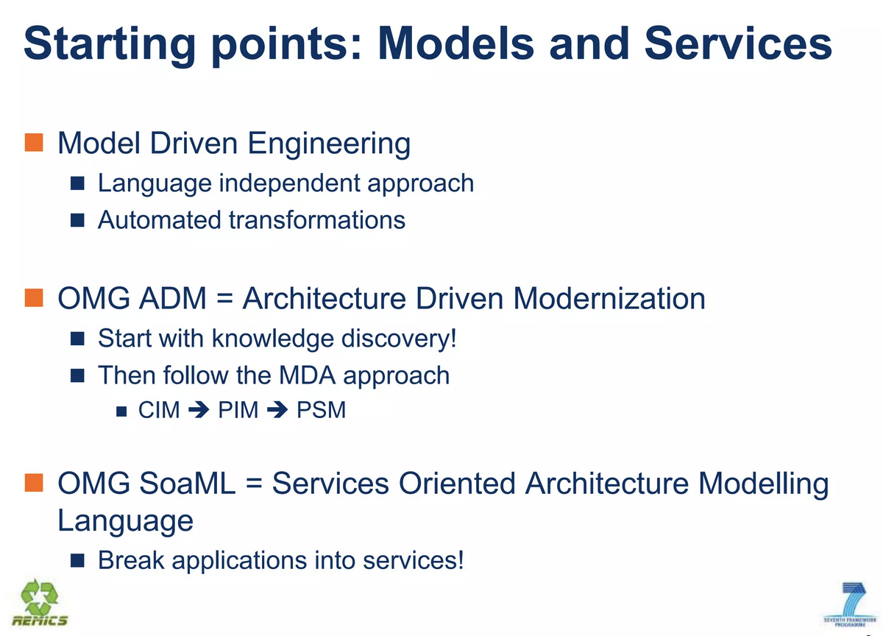

Slide 35
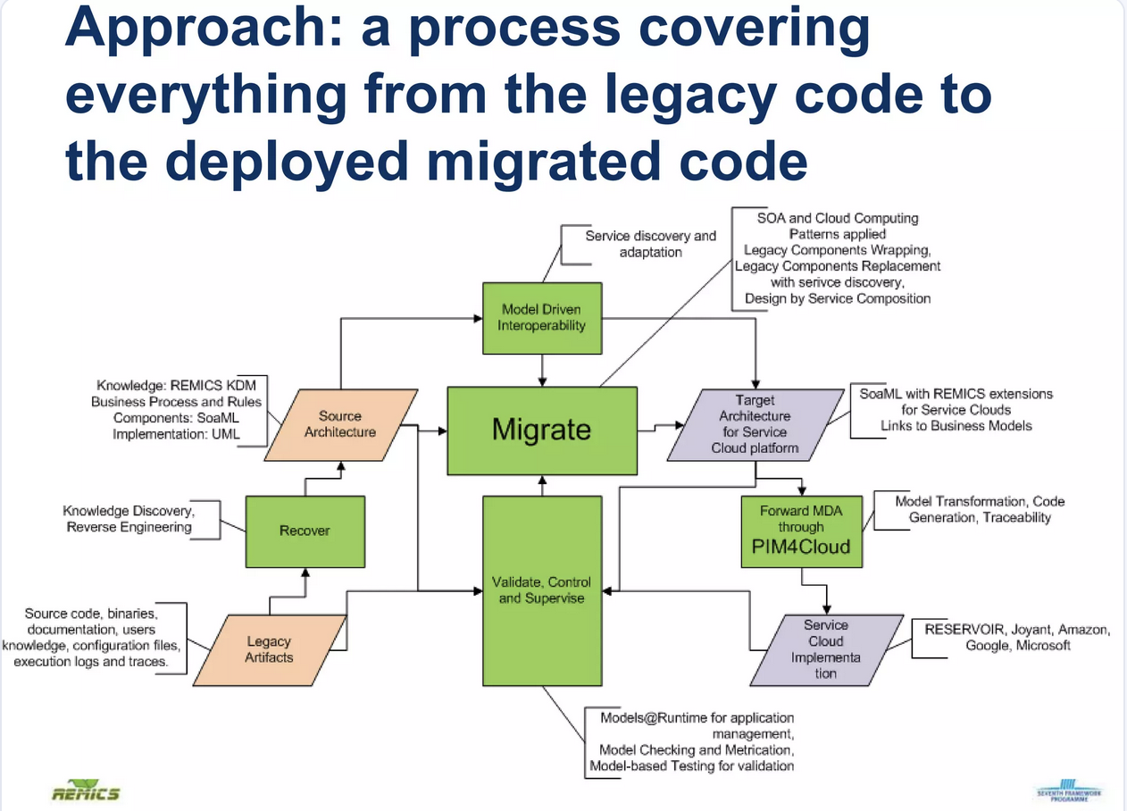

Slide 36
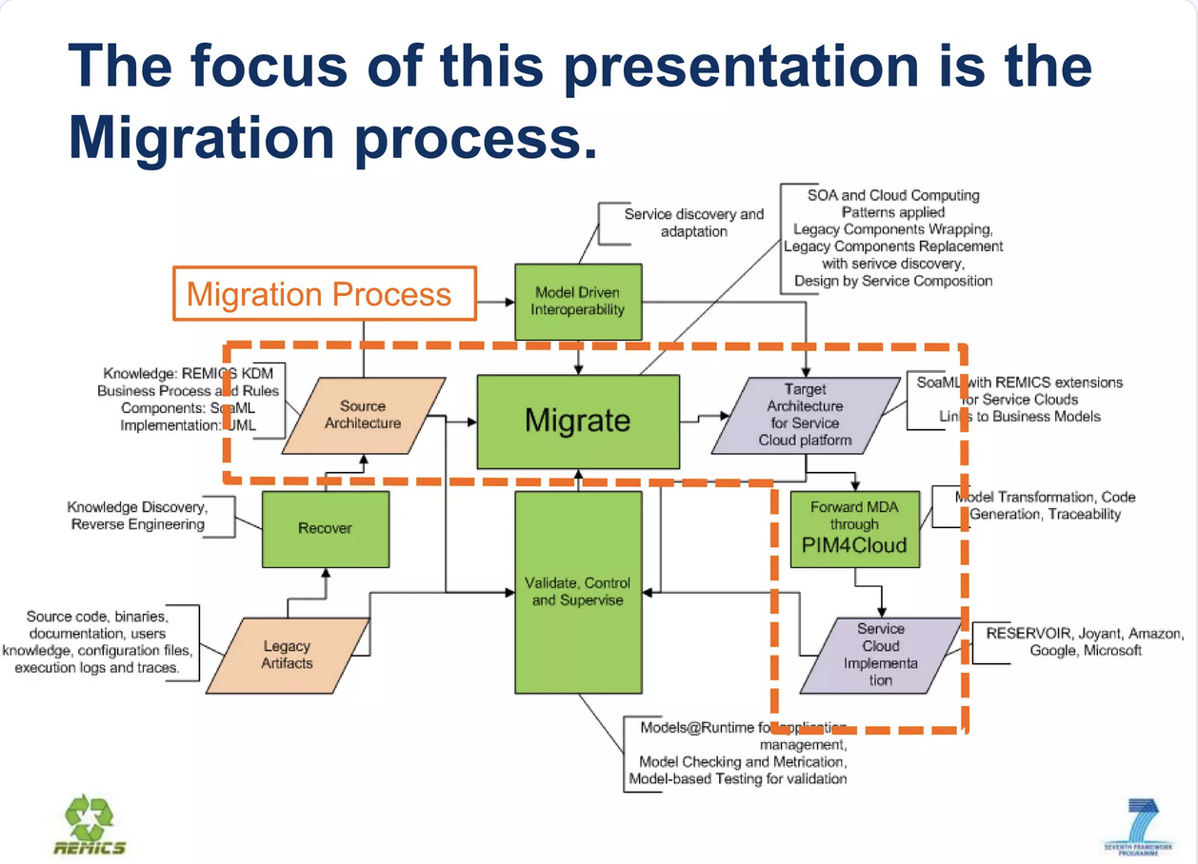

Slide 37
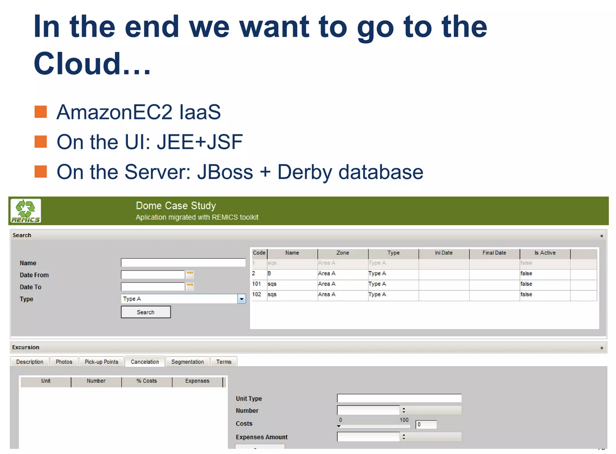

Slide 38
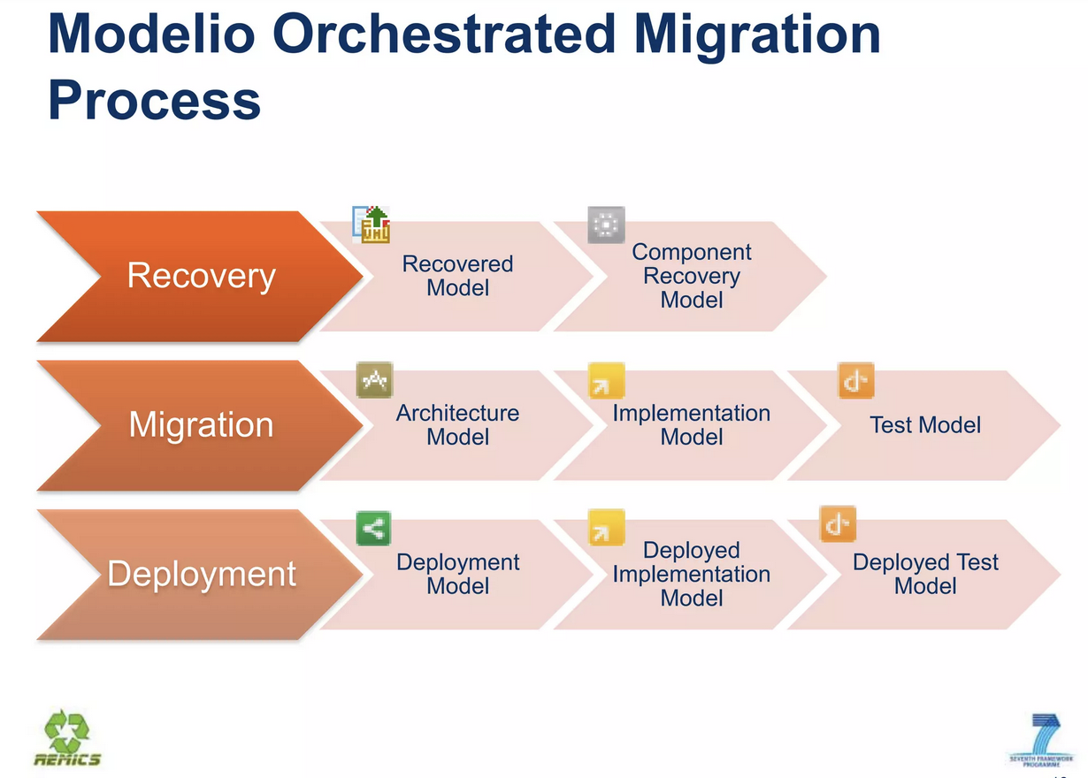

Slide 39
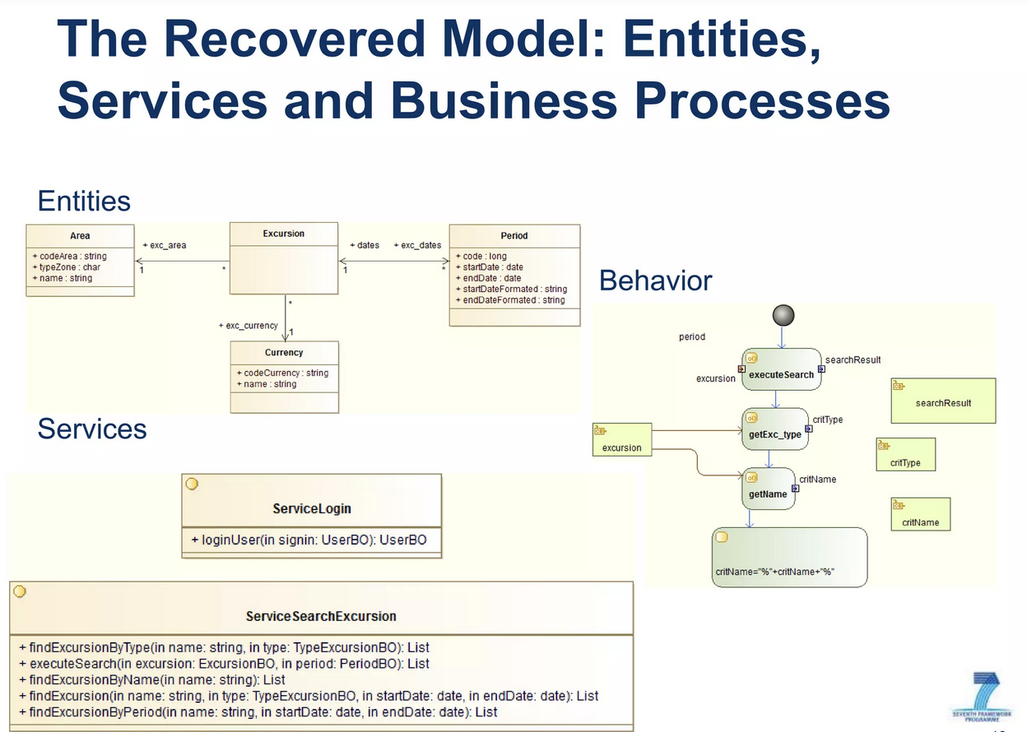

Slide 40
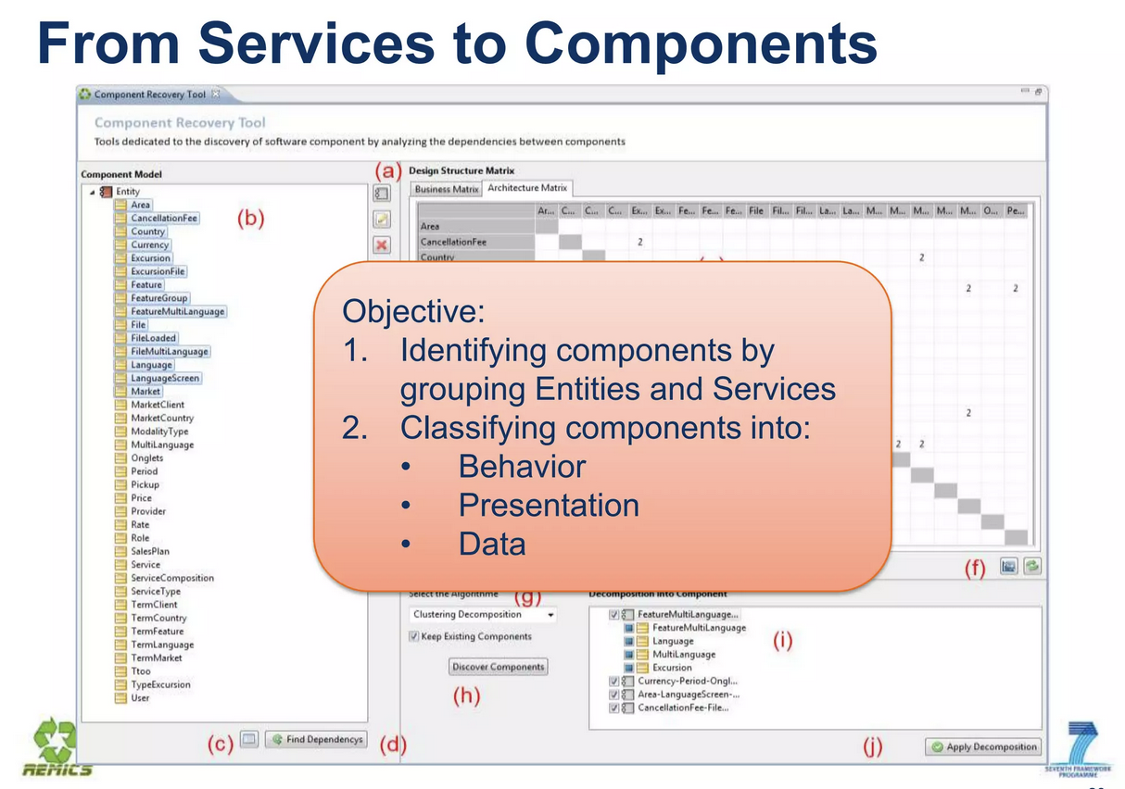

Slide 41
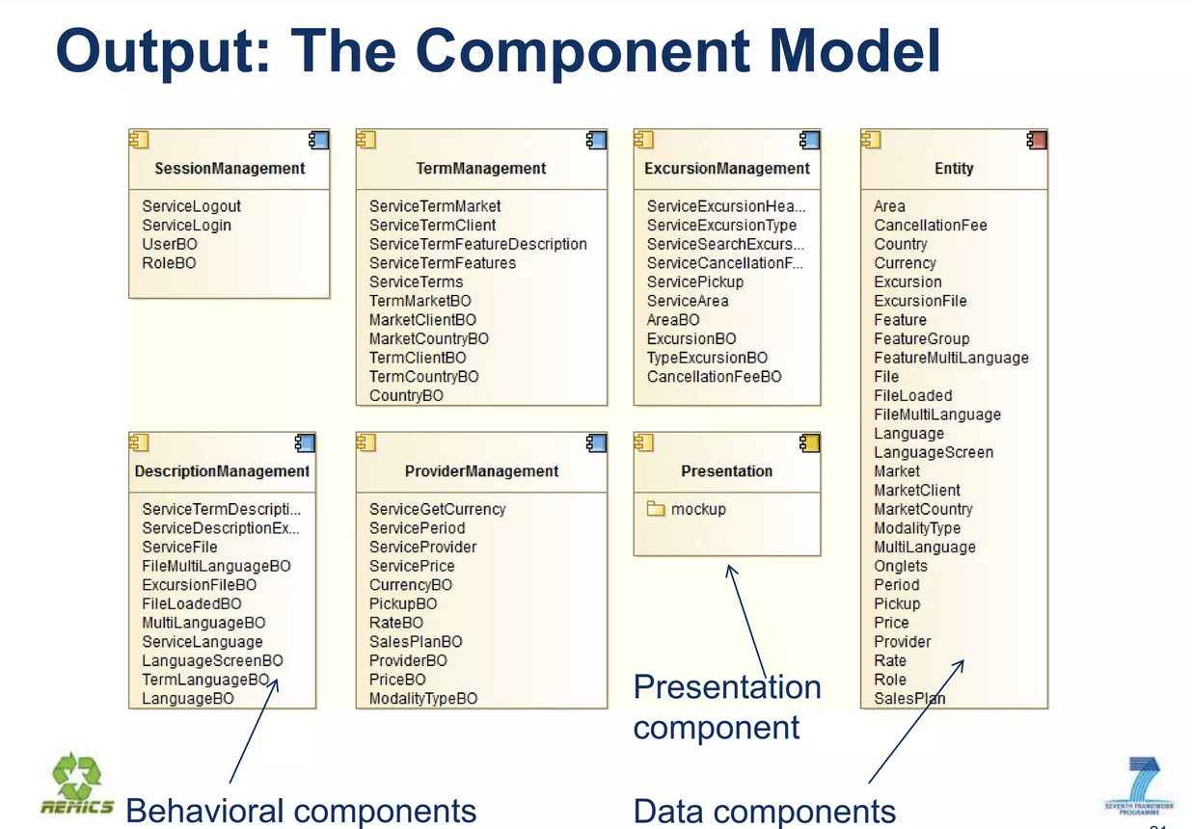

Slide 42
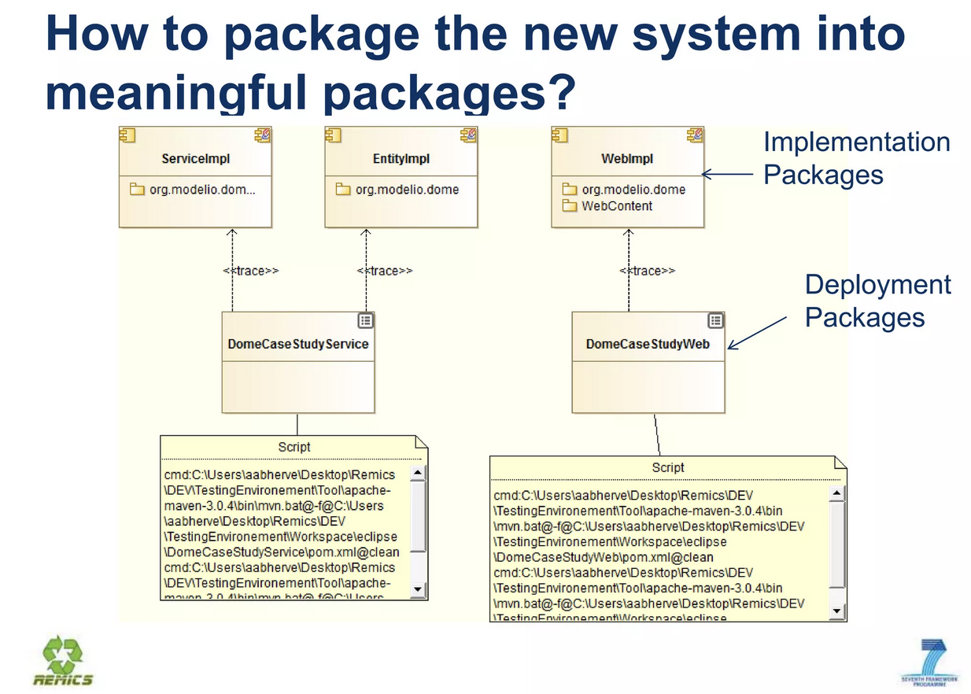

Slide 43
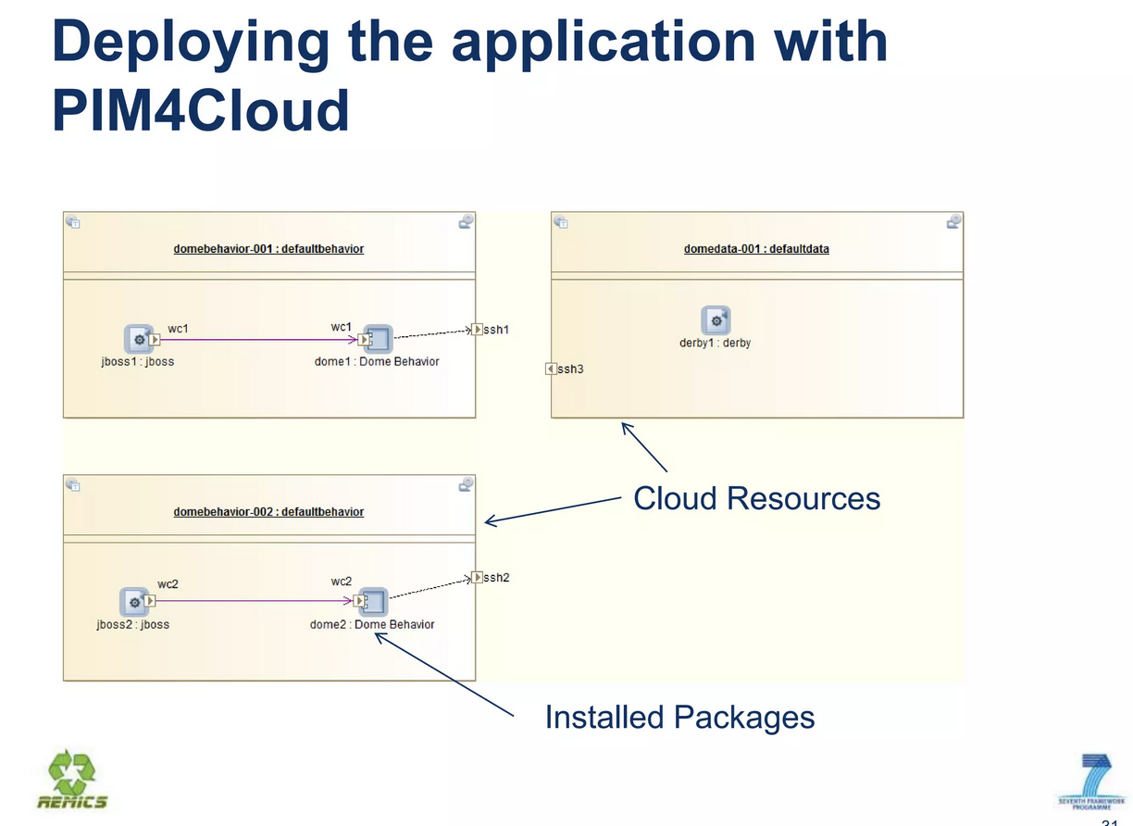

Slide 44
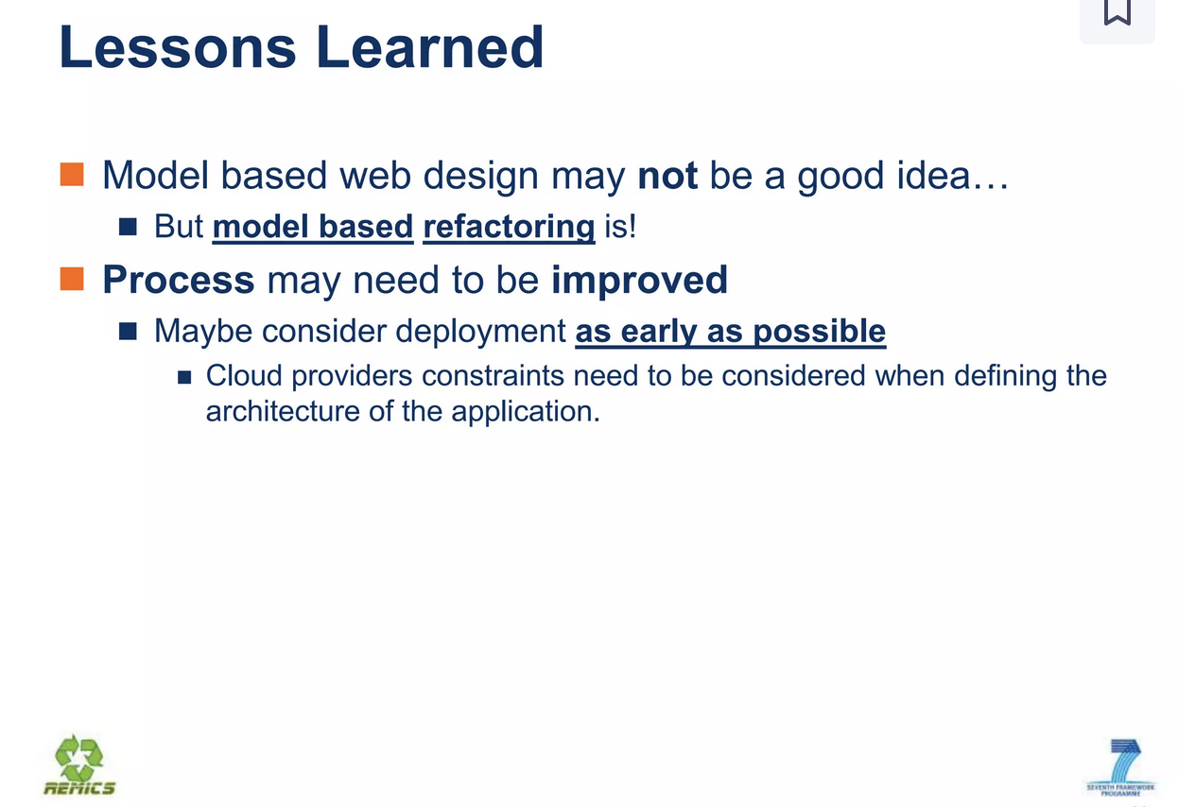

Slide 45
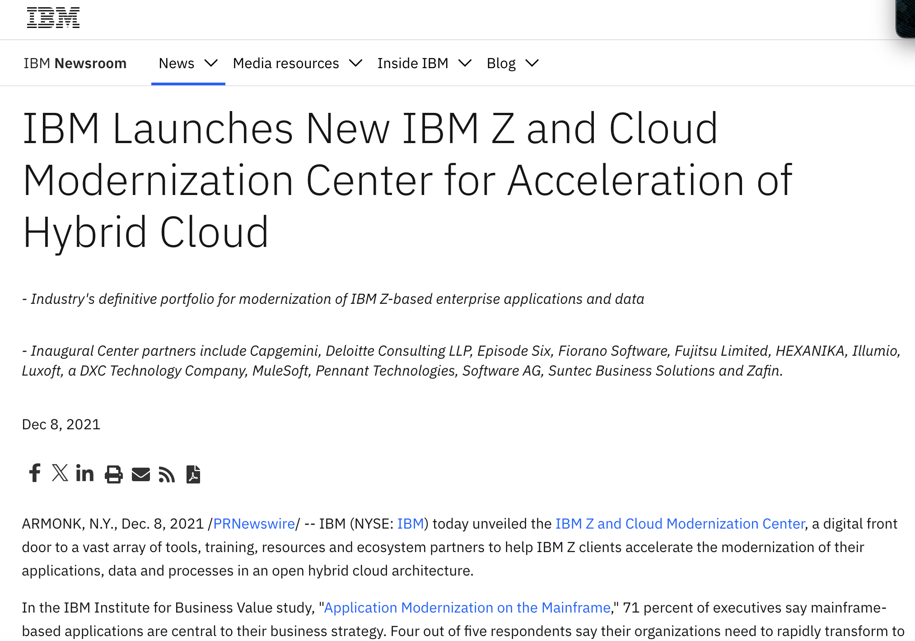

Slide 46
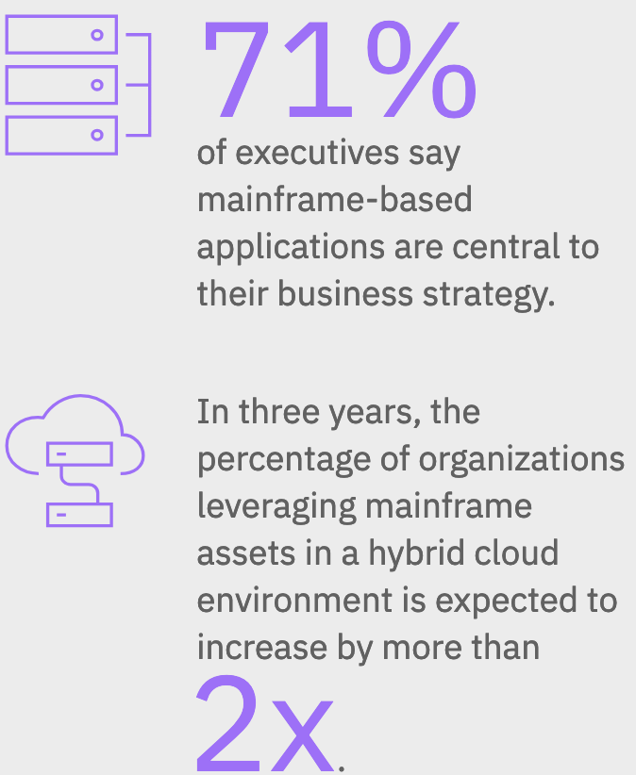
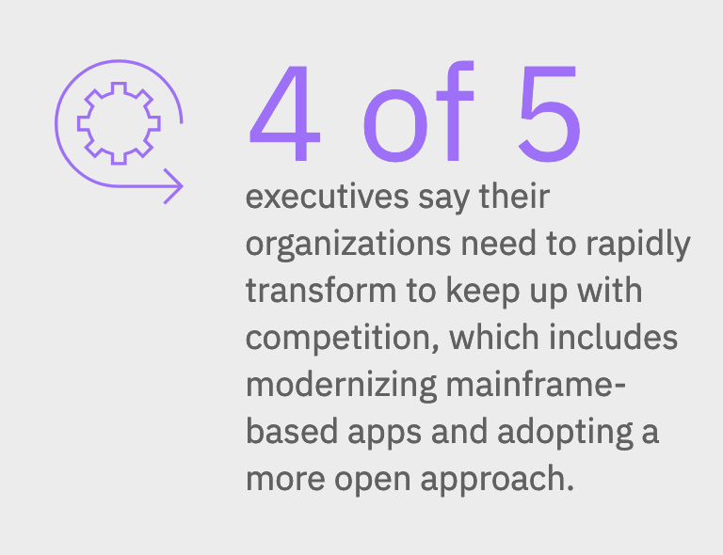

Slide 47
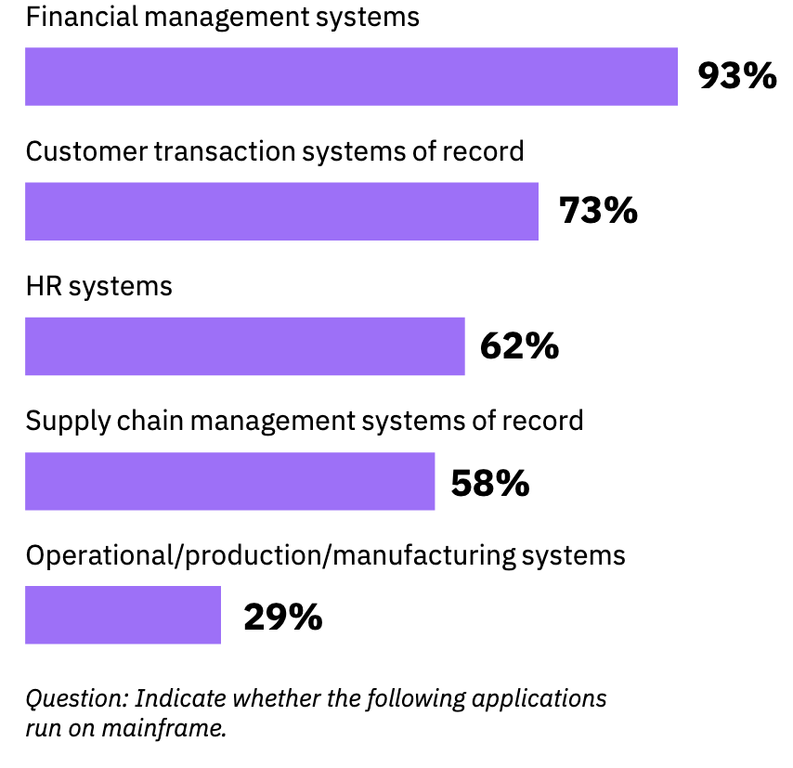
Mainframe: Is it still relevant?

Slide 48
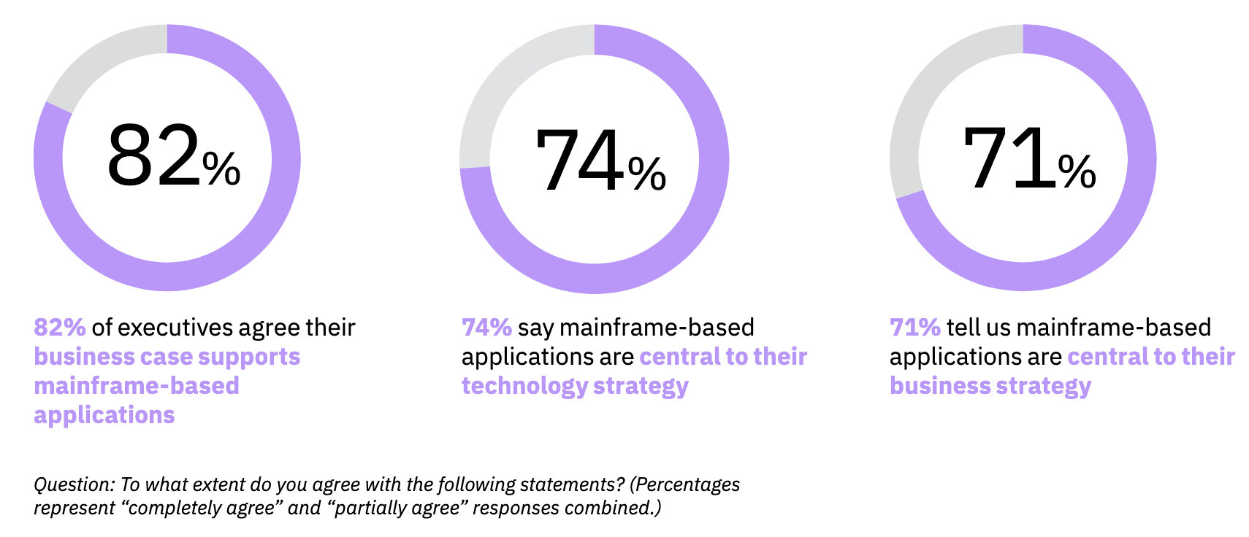
A core element for the future

Slide 49
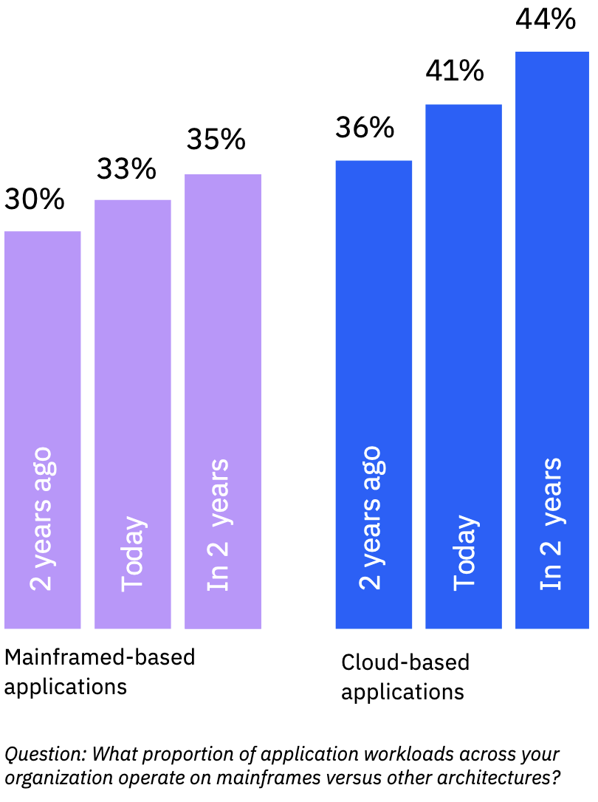
Growth for both

Slide 50
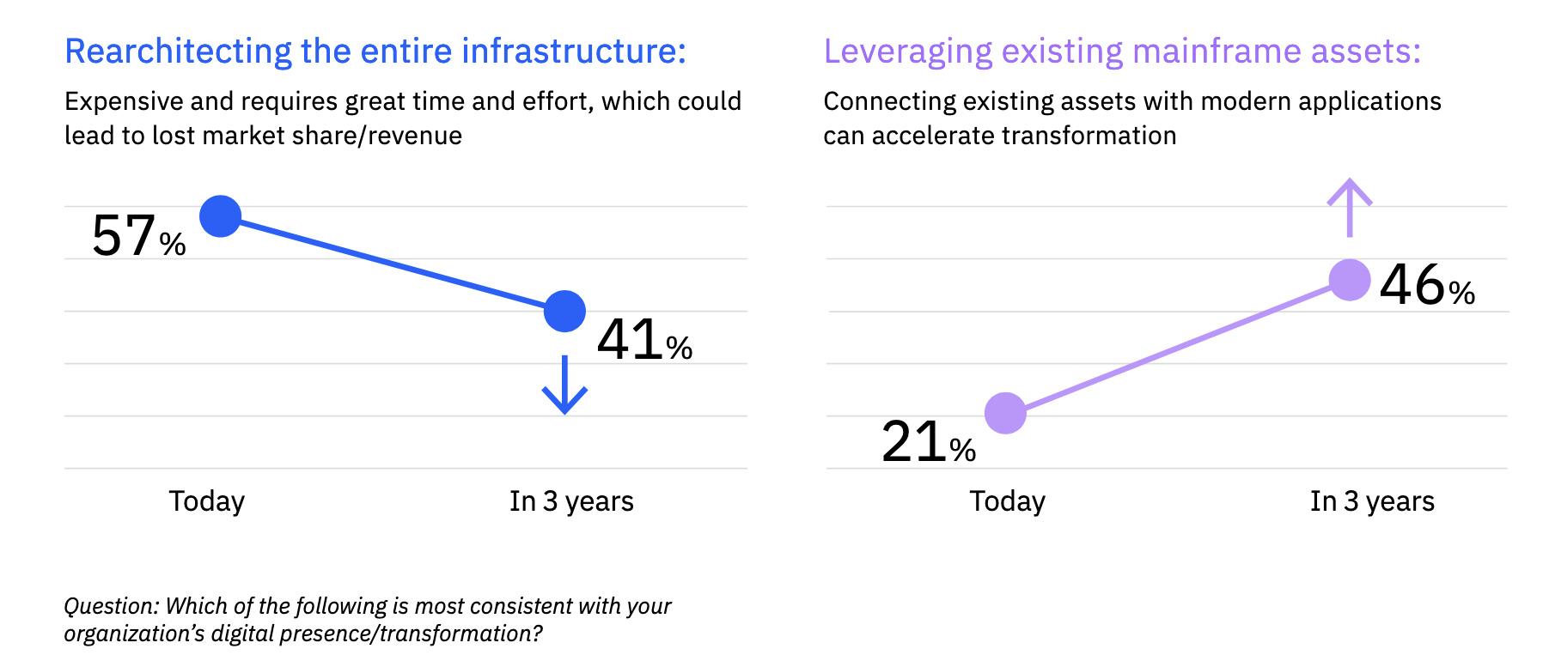
Transformation includes modernization

Slide 51
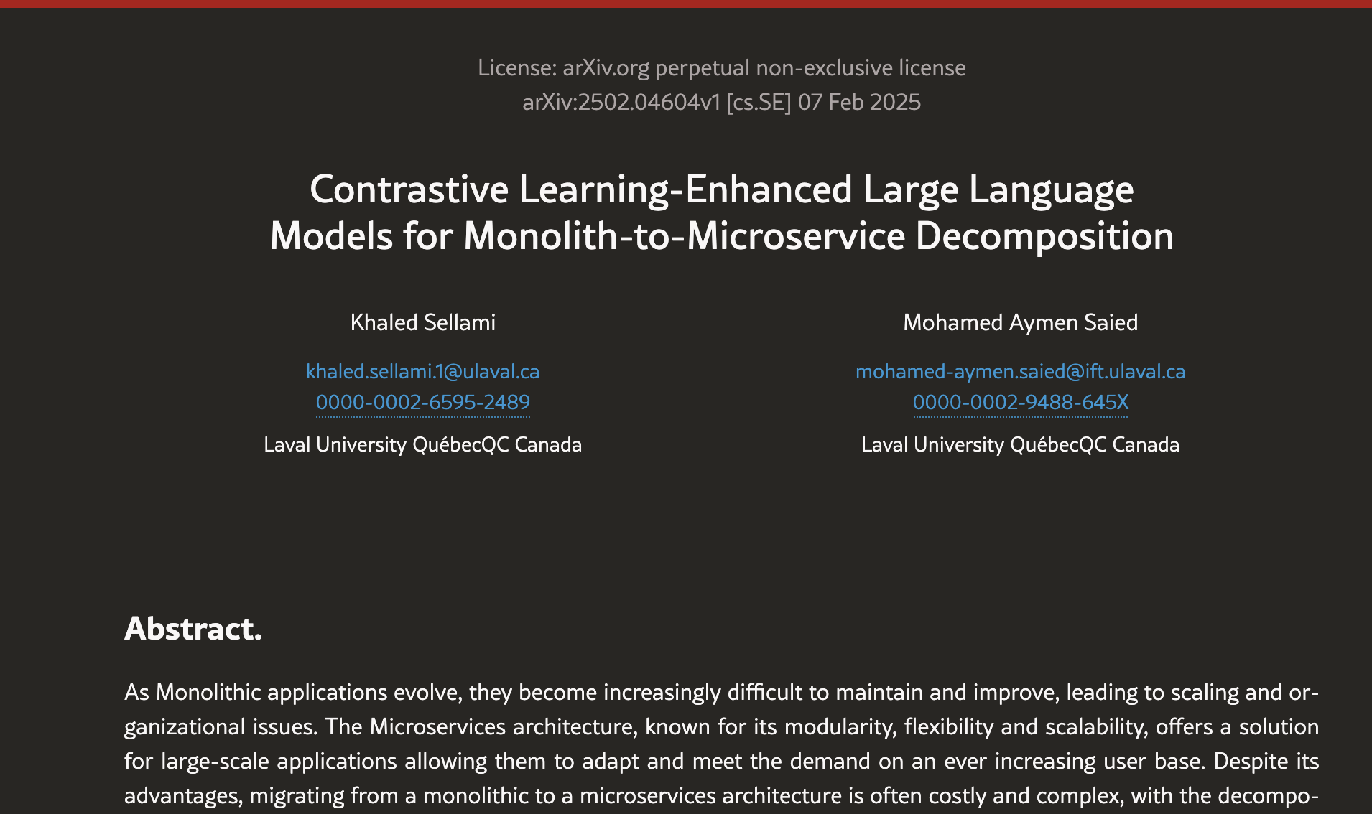
The LLM Bit…

Slide 52
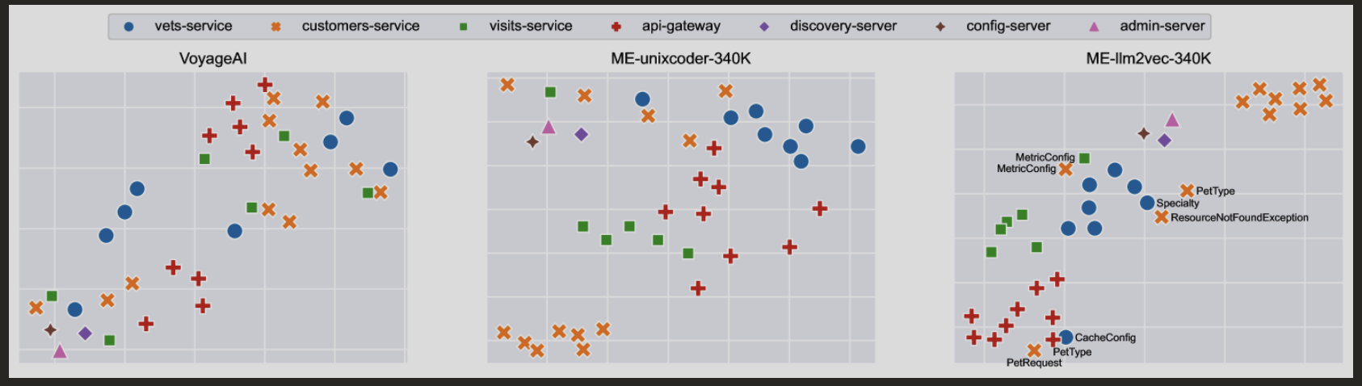
The LLM Bit…
From 0.8 to 6.2 times better than other (rule-based) approaches;
Performance does not scale w.r.t. proj. size;
Affinity Propagation is avg. better, K-Means and Hierarchical better when given the number of microservices;

Slide 53
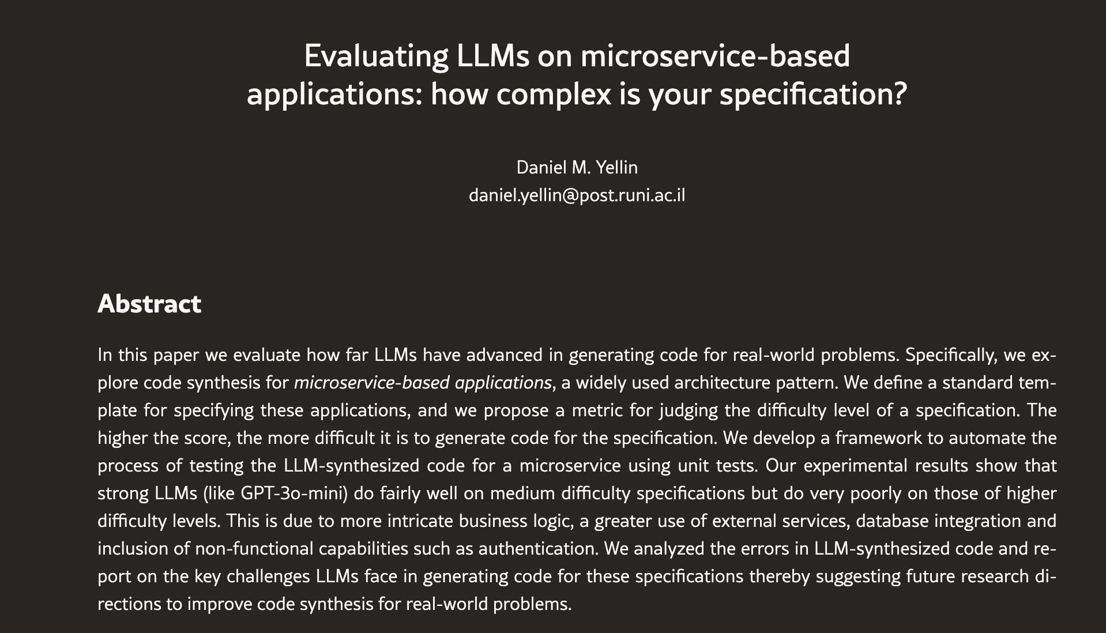
The LLM Bit… (cont’d)

Slide 54
The LLM Bit… (cont’d)
strong LLMs (like GPT-3o-mini) do fairly well on medium difficulty specifications but do very poorly on those of higher difficulty levels;
>intricate business logic ➔ <<LLM performance;
Others:
  greater use of external services,
  database integration
  inclusion of non-functional capabilities (+authentication);

Slide 55
Wrapping it up…
Microservices are the next-gen iteration of software architectures, mainframe scenario is key and relevant.
Key problem: migrating to µS from monoliths!
  Monoliths are still very much typical in industry!
Mainframe ➔ µS Configurations also require evolution
Microservice Migration Patterns aid in planning µS migration!

Slide 56

Questions?
Notes:
https://www.slideshare.net/slideshow/blu-agemd-day2011/10429397

